Slide 1
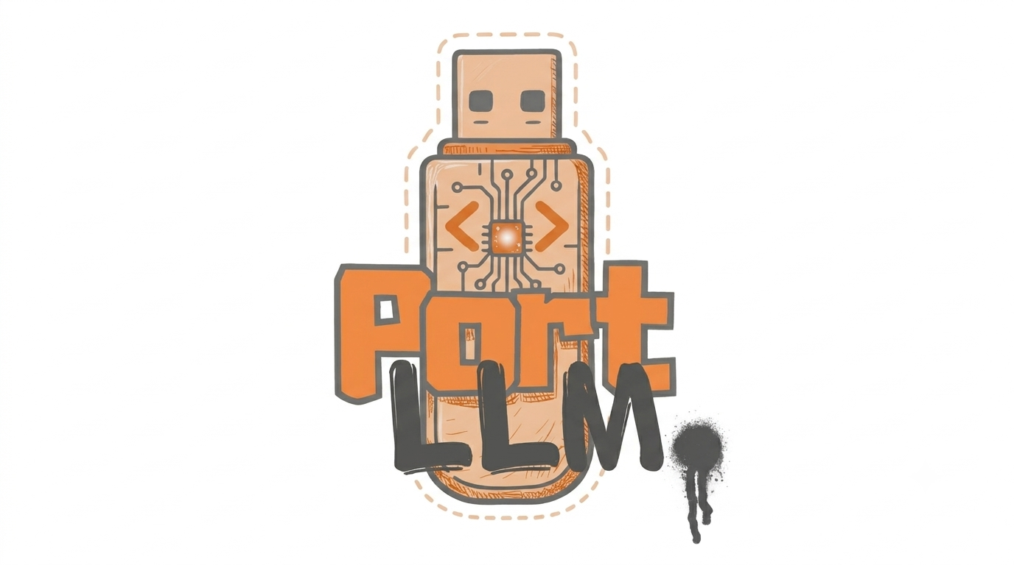

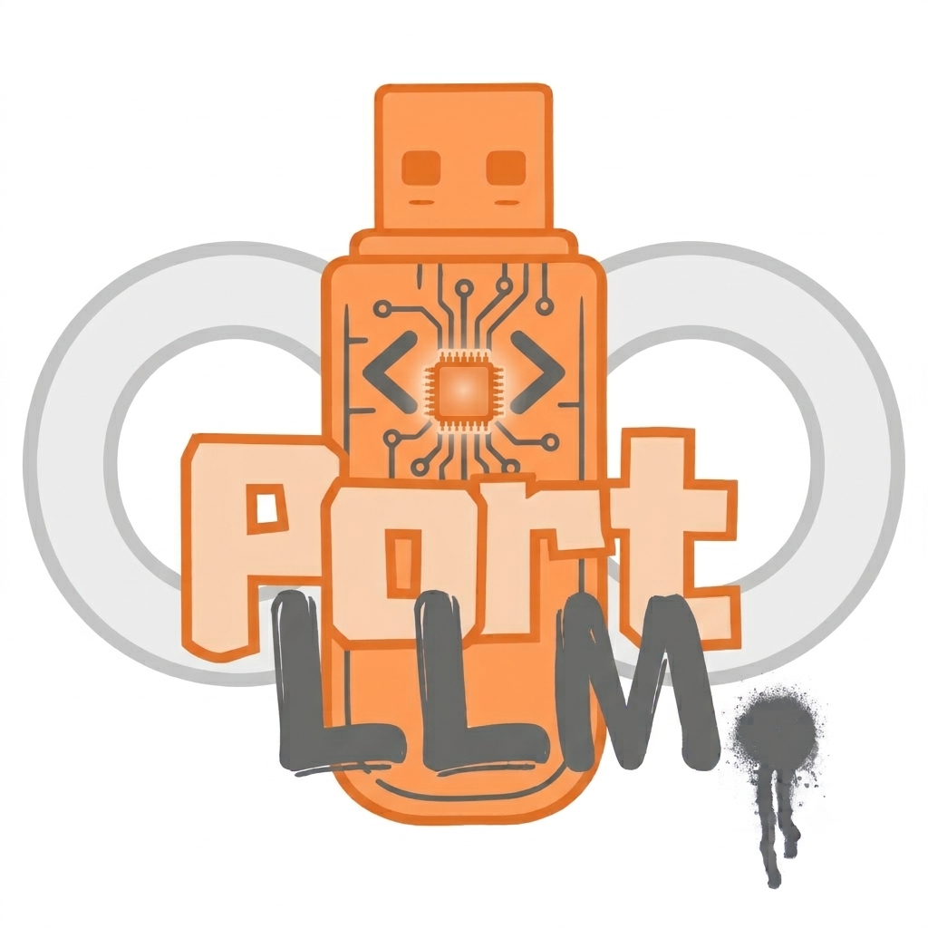
Colossal-a-Pitch
Team Leader - Keshav Gupta
Team members – Abhishek Choudhary
Khushal Varshney
Project Title – PORT LLM
Project link - https://port-llm.vercel.app/
Github- https://github.com/Keshav-pro1/PORT-LLM-
Team Name – Baniya Monopoly

Slide 2
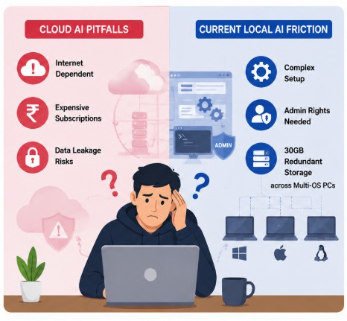
PROBLEM STATEMENT
Digital Divide & Connectivity Gaps in Bharat
Rural schools, colleges, defense outposts, and remote healthcare centers often have unreliable or zero internet connectivity.
This limits access to modern Generative AI capabilities.
Data Sovereignty & Privacy Risks
Cloud-based AI services may transmit proprietary source code, legal records, and medical files to remote servers.
This creates privacy, security, and data-sovereignty concerns.
Recurring Costs & Cloud Dependency
Proprietary LLM APIs often require recurring subscriptions or usage-based payments.
This creates a financial barrier for students, researchers, and small institutions.
Friction & Host System Pollution
Existing local AI tools may require installation, administrator privileges, environment configuration, and large model downloads on every machine.

Slide 3
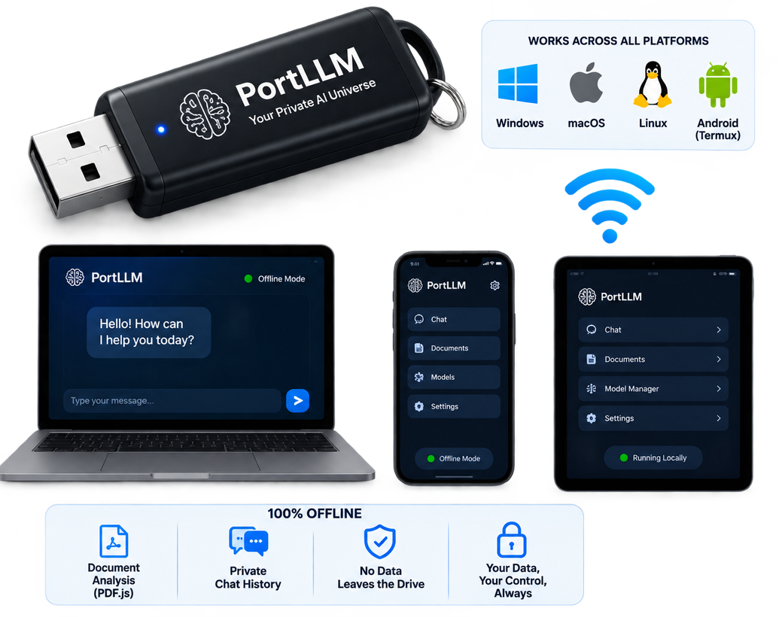
SOLUTION
PortLLM — Sovereign AI in Your Pocket
A zero-dependency, plug-and-play local AI compute environment that runs entirely in user-space from a USB drive, SSD, or local folder.
Download Once, Run Everywhere
Unified architecture for Windows, macOS, Linux, and Android via Termux.
Shared GGUF model files eliminate unnecessary duplicate storage.
100% Air-Gapped & Private
Inference runtimes, document parsers, fonts, and chat histories remain on the physical drive.
Designed to operate without external network calls.
Zero Host Machine Footprint
No installation wizard.
No registry modifications.
No persistent background services.
Unplugging the drive leaves the host machine untouched.
Instant Boot
Plug in the drive.
Launch PortLLM.
Start chatting through the local dashboard at localhost:3333.

Slide 4
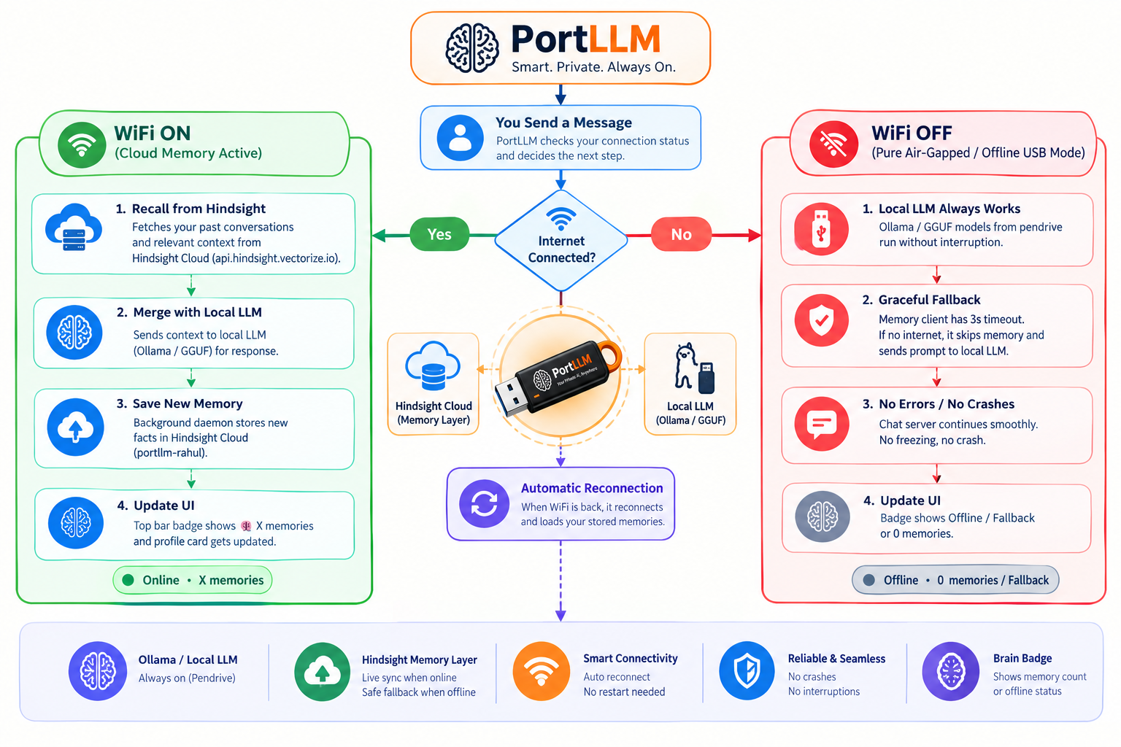
Hindsight Implementation
Persistent Memory – Zero Downtime
Role-Aware Intelligence
•Recalls relevant past conversations and user context to generate personalised responses.
Offline Reliability
• Learns user roles, preferences, and recurring workflows over time.
• Enables governed knowledge sharing across departments when online.
Privacy & Access Control
• Synchronises memories through cloud connectivity while PortLLM continues local inference offline.
Cross-Department Knowledge Sharing
• Reduces repeated explanations, improves productivity, and supports role-aware collaboration.

Slide 5
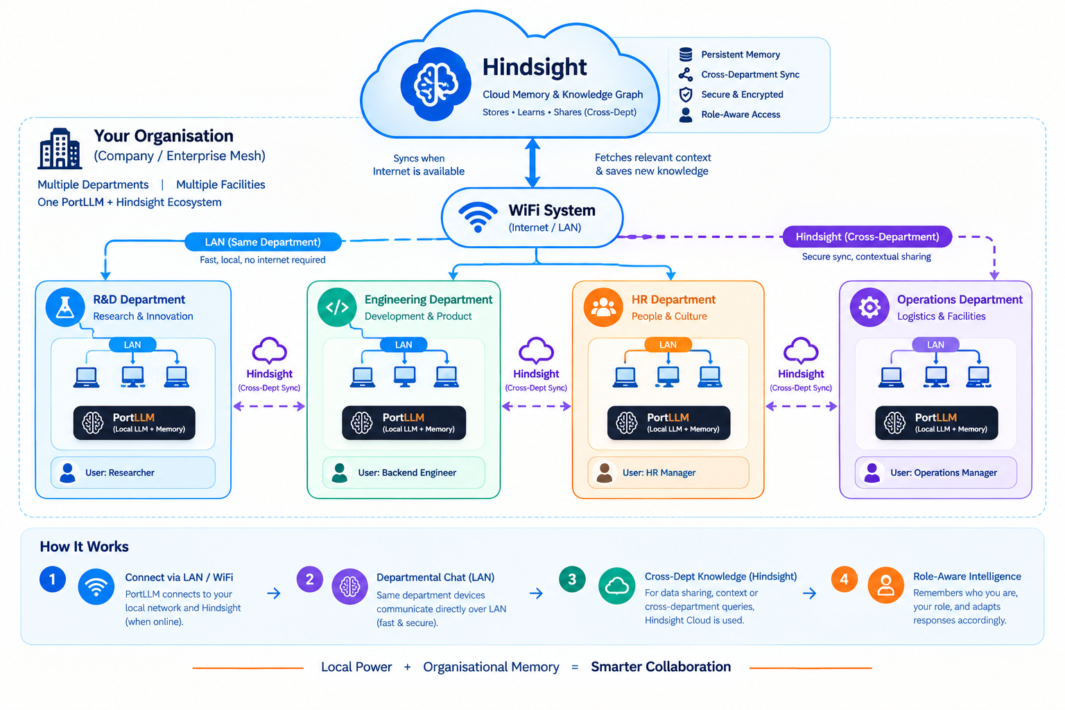
Workflow
Persistent Memory – Zero Downtime

Slide 6
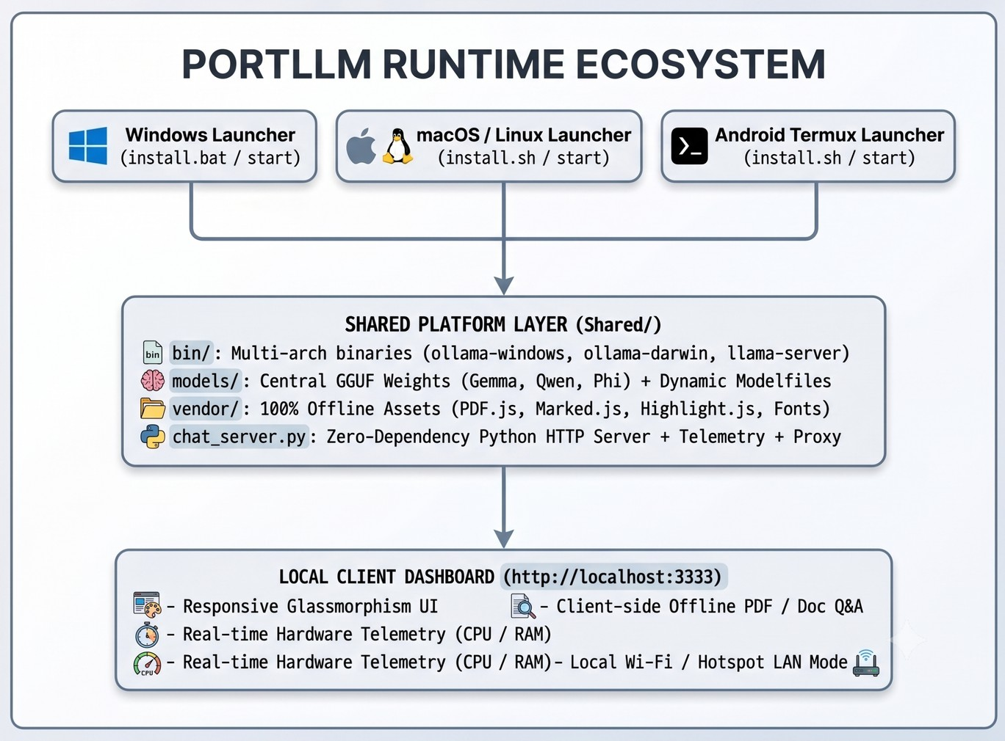
FLOW OF SOLUTION
Layer 1 — Platform Launchers
Windows
install.bat
start-portllm.bat macOS / Linux
install.sh
start.sh Android
Termux + llama-server
Layer 2 — Shared Core Layer
Shared/bin/
Pre-compiled inference engines including Ollama and llama.cpp. Shared/models/
Central repository for GGUF model weights shared across supported platforms. Shared/vendor/
Offline web assets including PDF.js, Marked.js, Highlight.js, Inter, and JetBrains fonts. Shared/chat_server.py
Zero-dependency Python HTTP server.
Hardware telemetry collector.
Local reverse proxy.
Layer 3 — Client Interface
Standalone Web Dashboard
Local interface available at localhost:3333.
Client-side PDF analysis.
Real-time CPU and RAM monitoring.
Local chat interface.

Slide 7
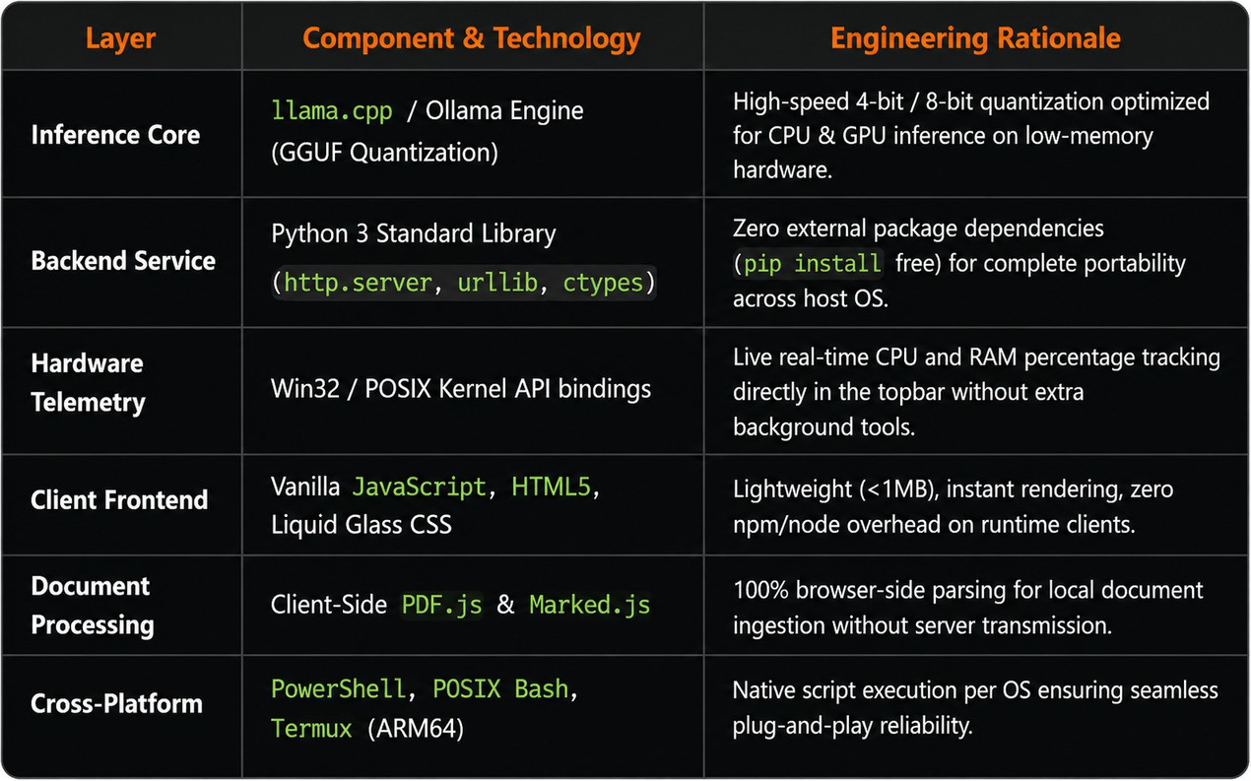
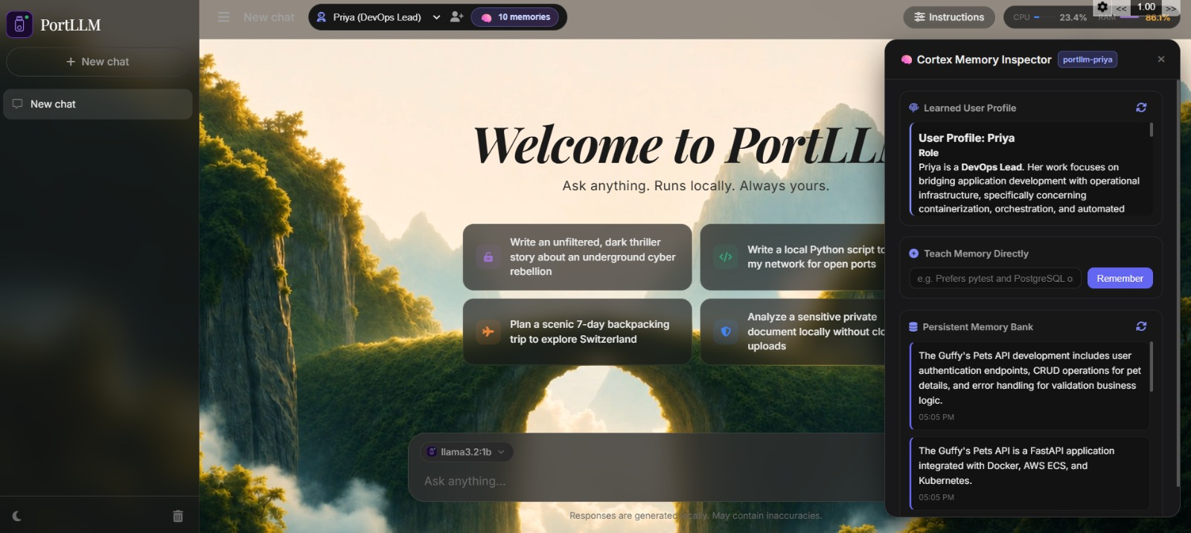
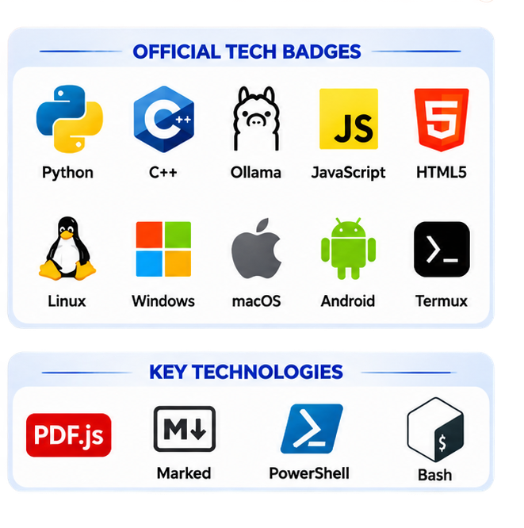











TECH STACK

Slide 8

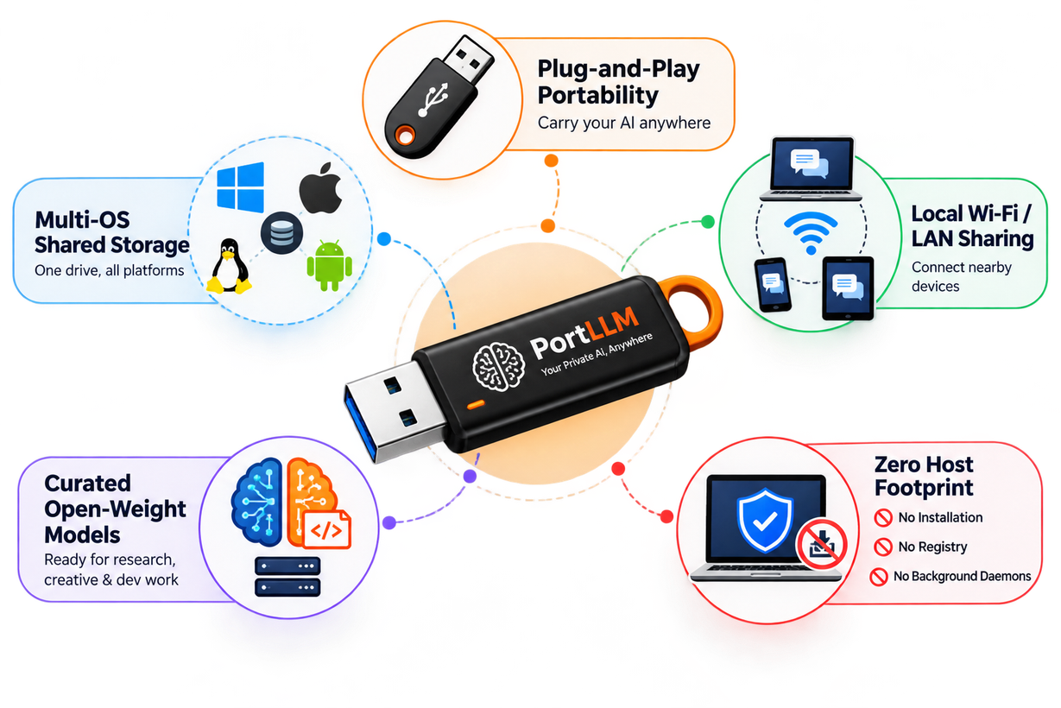
UNIQUE SELLING PROPOSITION (USP)
True Plug-and-Play Portability
Complete AI environment contained inside a portable drive.
Plug into a compatible computer and launch the local AI environment.
Multi-OS Shared Model Storage
Windows, macOS, Linux, and Android can access the shared GGUF model repository.
Reduces unnecessary duplicate model storage.
Local Wi-Fi / LAN Hotspot Sharing
Host the AI model on one laptop.
Allow nearby phones and tablets to connect over local Wi-Fi without internet.
Curated Open-Weight Models
Supports configurable open-weight models for programming, research, and creative workflows.
Model selection can be tailored to specific use cases.
Zero Host Footprint
Designed to operate from user space.
No persistent installation required.
No registry modifications or background daemons.
W I T H
भारत

Slide 9

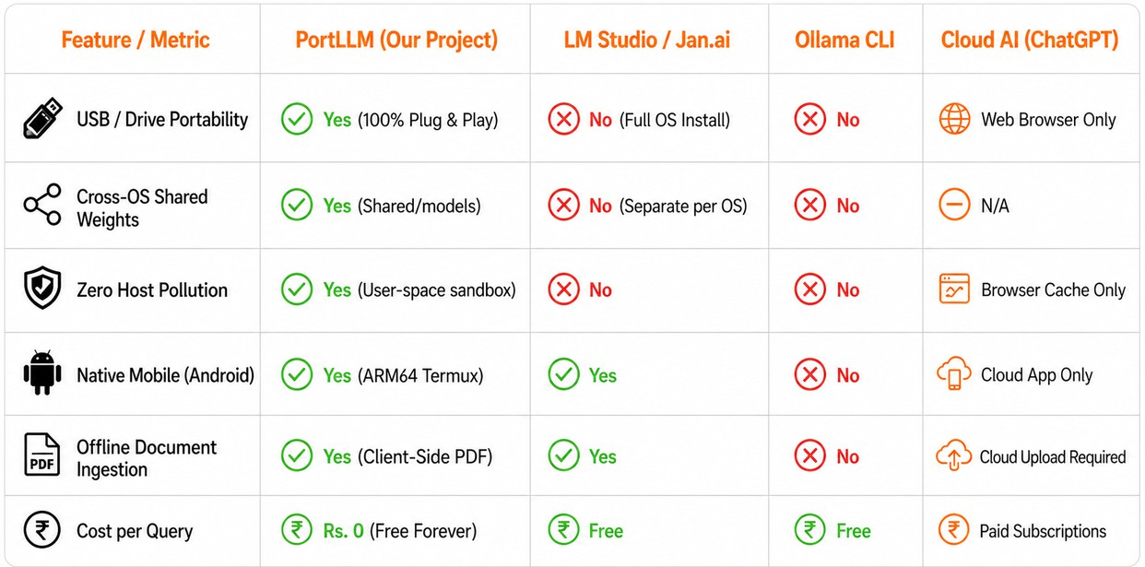
FEASIBILITY & COMPETITORS
KEY TECHNICAL CHALLENGES OVERCOME
Cross-Platform Compatibility
Built native launch scripts for Windows, Linux, macOS and Android/Termux while maintaining a common shared model architecture.
Portable Model Path Handling
Solved drive/path dependency issues by dynamically resolving absolute paths, ensuring PortLLM works correctly from any USB or local directory.
Zero-Dependency Runtime
Implemented the backend using Python Standard Library, eliminating external package installation and reducing host-machine dependencies.
Process & Resource Management
Optimized inference process handling and hardware telemetry to prevent pipeline deadlocks while maintaining real-time CPU/RAM monitoring.

Slide 10
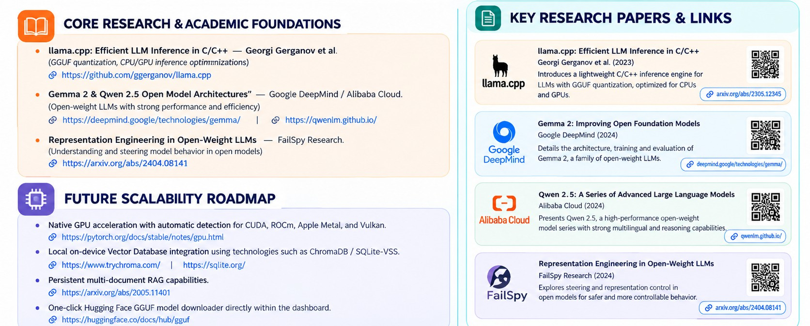
RESEARCH & REFERENCE

